Slide 1
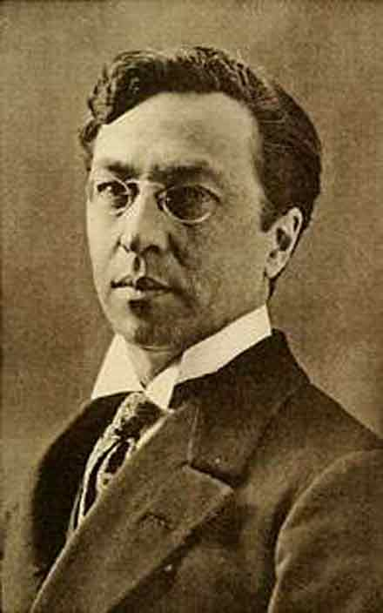
Wassily Kandinsky

Slide 2
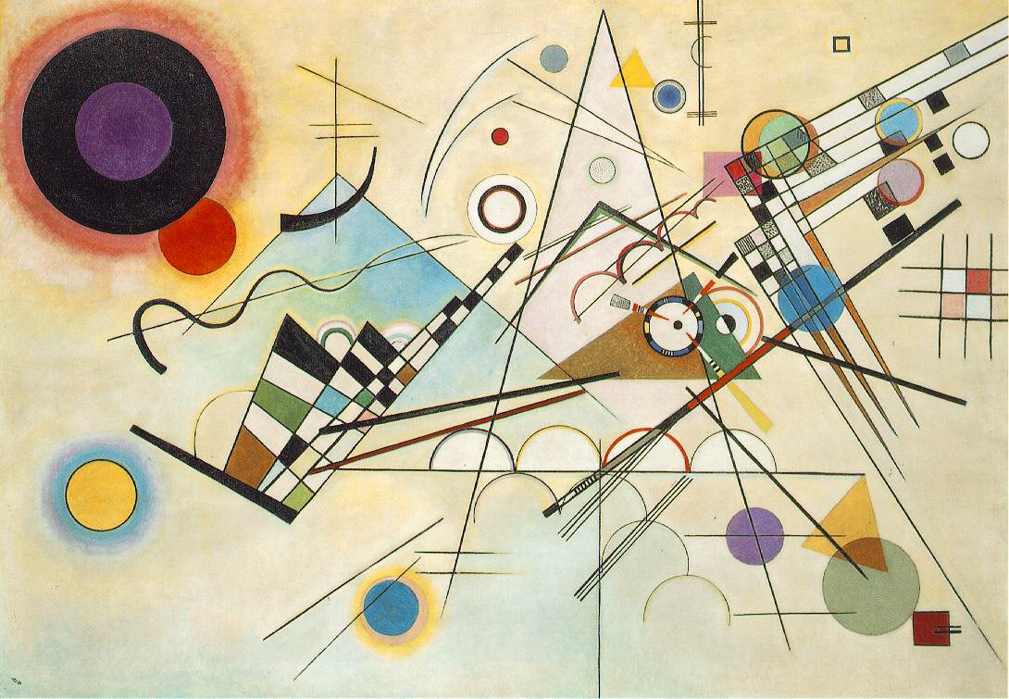
Composition VIII - 1923 (8)

Slide 3
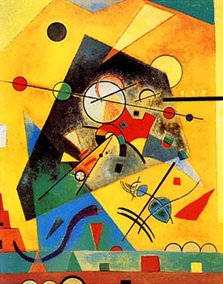
Harmonie Tranquille

Slide 4
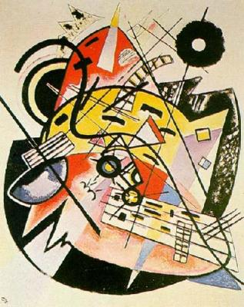
The White Dot

Slide 5
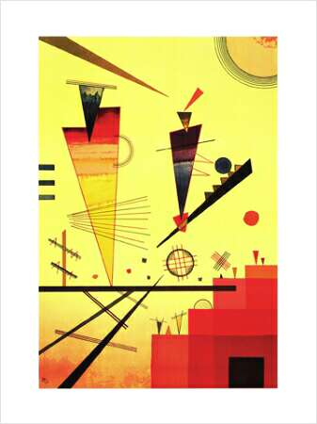
Structure Joyeuse

Slide 6
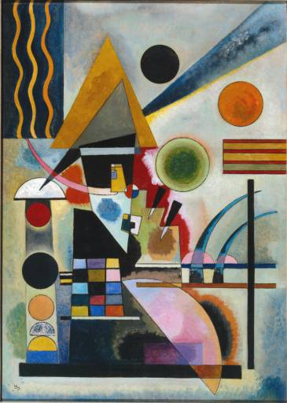
Swinging Schaukeln 1925

